Slide 1
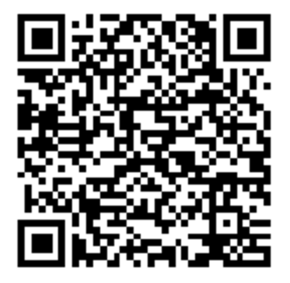

NativeScript & Angular 2
Start your installation at http://docs.nativescript.org/
tutorial/chapter-1
You know Angular. Now you know mobile.

Slide 2
TJ VanToll
Jen Looper
@tjvantoll
@jenlooper

Slide 3
Agenda
What is NativeScript?
~30 minutes
Installation?
~10 minutes
Hands-on guide
~1 hour
Final Q&A
~10 minutes

Slide 4
Created and supported by Telerik
Notes:
I mention this because, in today’s world, where 10 JavaScript frameworks have been created since I started this presentation, that it’s important to pick an innovative and stable options

Slide 5
Delivering on the overdue promise of “hybrid.”

Slide 6
Hybrid Promise
100% Web
Hybrid
100% Native
Reach
Code/Skill Reuse
Richness
Premium experience
Device APIs
Best of both?

Slide 7
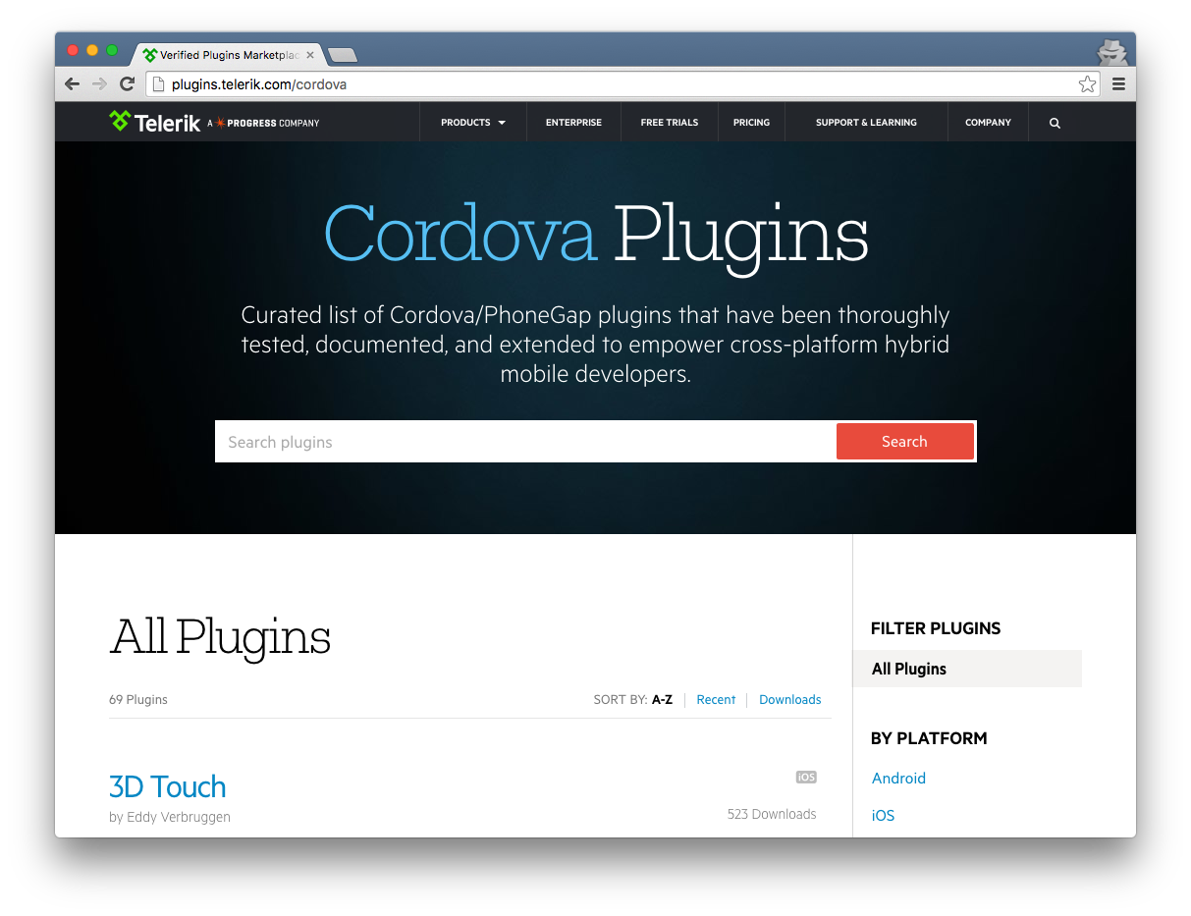

Slide 8
Early prototypes
“Core” engineering
Public launch
Adoption ramp-up
Mass adoption
2013
2014
2015
2016
2017
Project Timeline

Slide 9
NativeScript is…
an open source framework for building truly native mobile apps with JavaScript. Use web skills, like TypeScript, Angular and CSS, and get native UI and performance on iOS and Android.

Slide 10
The {N} difference…

Slide 11
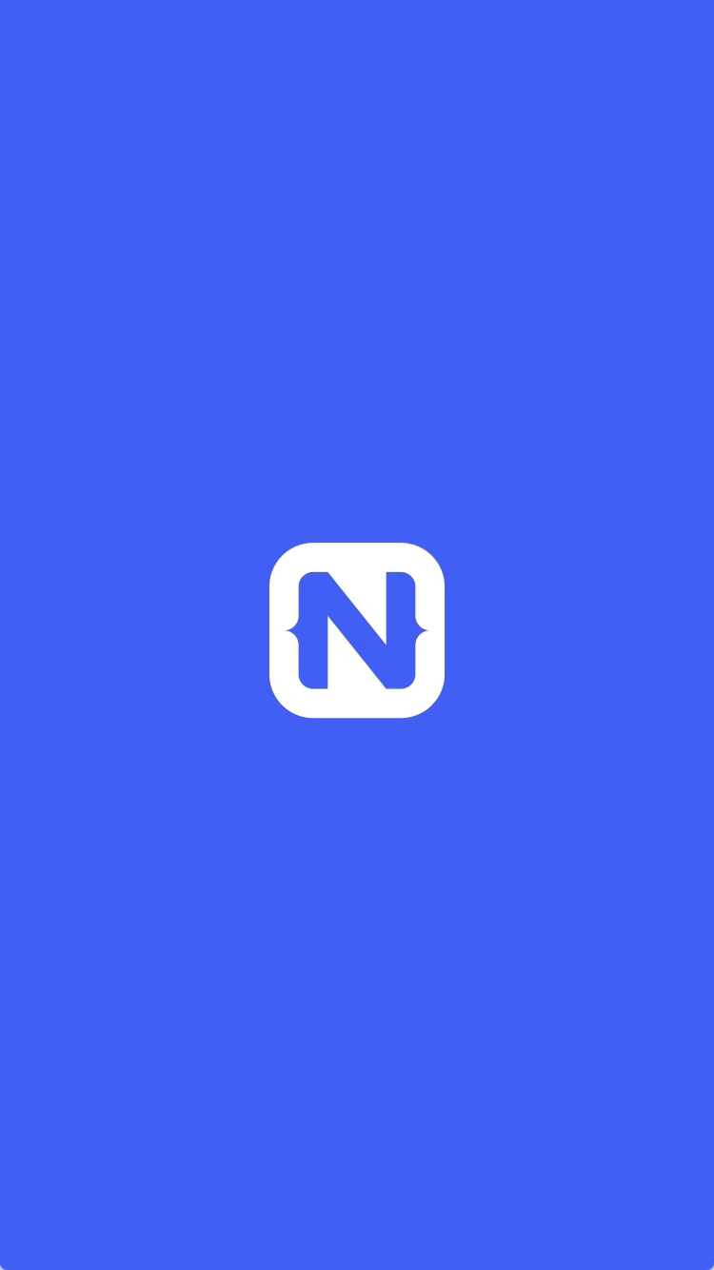
1
Rich, animated, “no compromise” native UI
(with shared UI code)
Search for
“Examples NativeScript”
in the iOS App Store or Google Play to try this out for yourself.

Slide 12
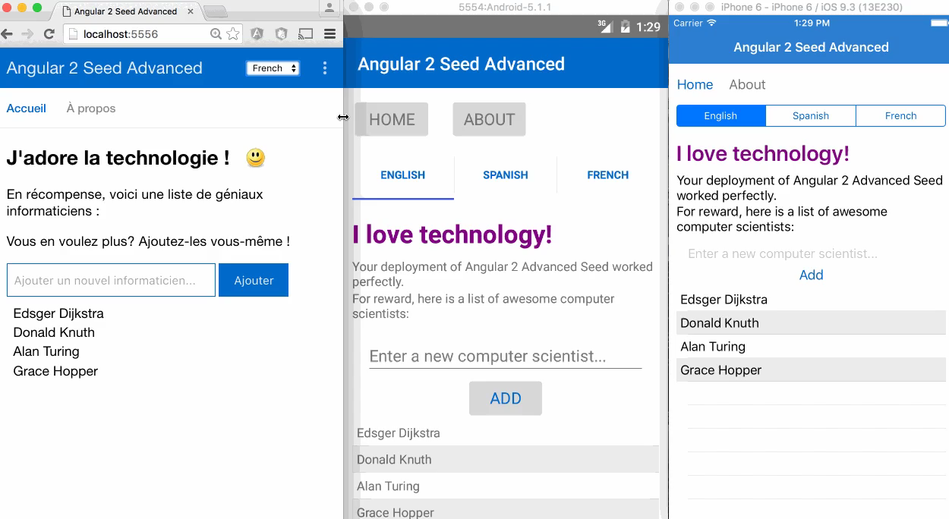
2
Maximum code and skill reusability
Video credit: Nathan Walker, {N} community member
Notes:
Npm, CocoaPods, Android Arsenal

Slide 13



3
First-class Angular and TypeScript support
+
=

Slide 14
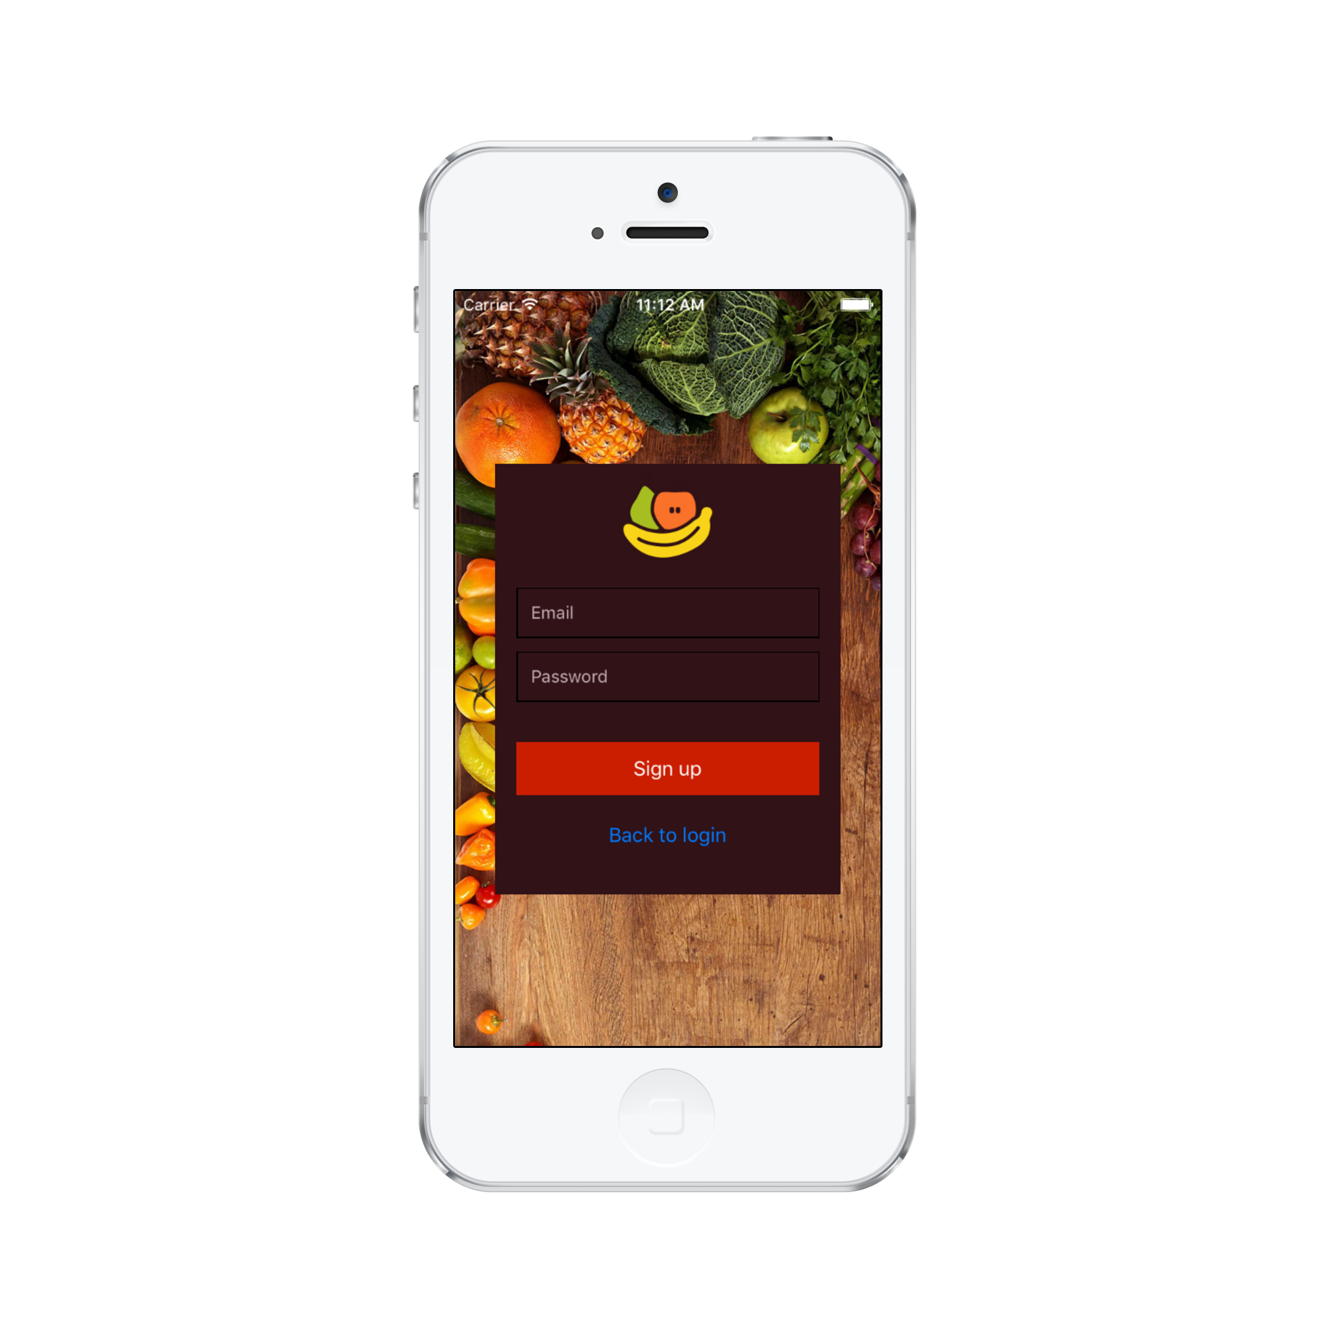
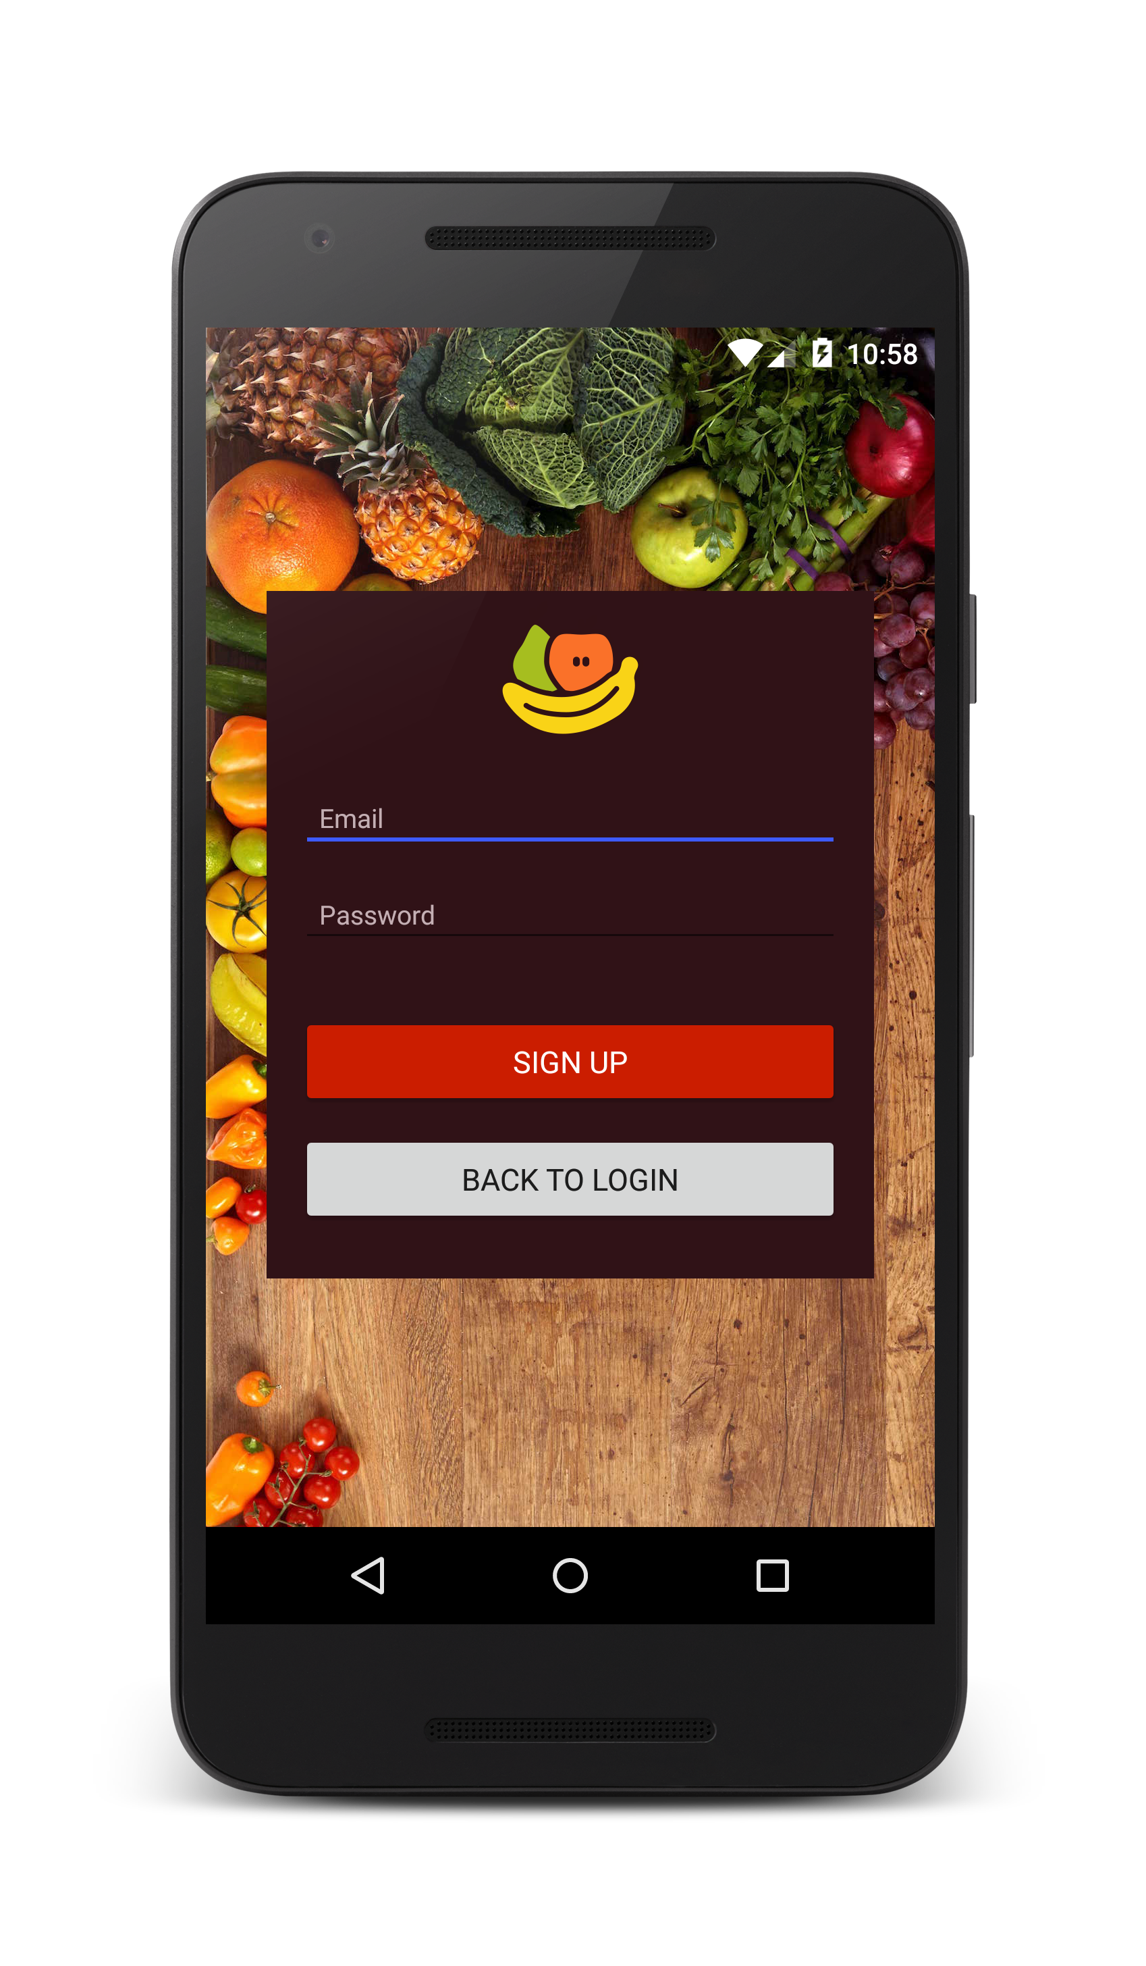

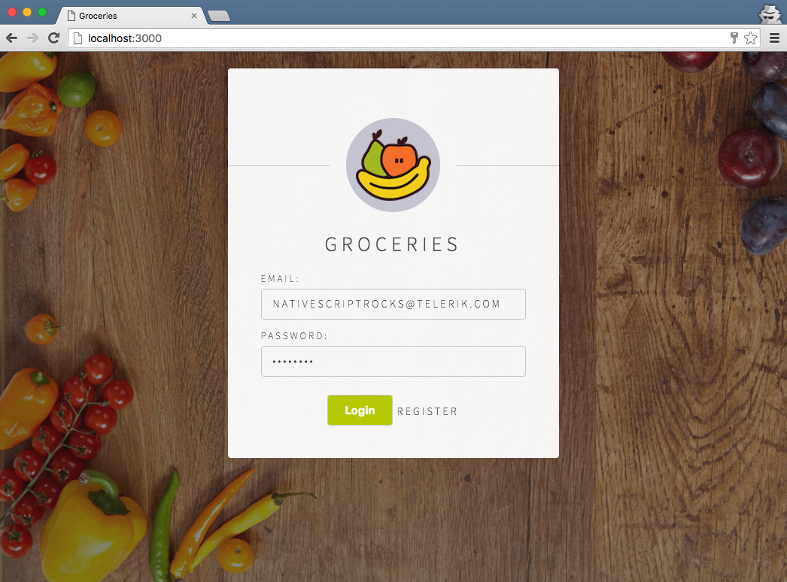
Android
iOS
Web
Notes:
Jen

Slide 15
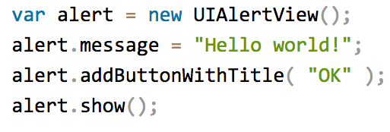
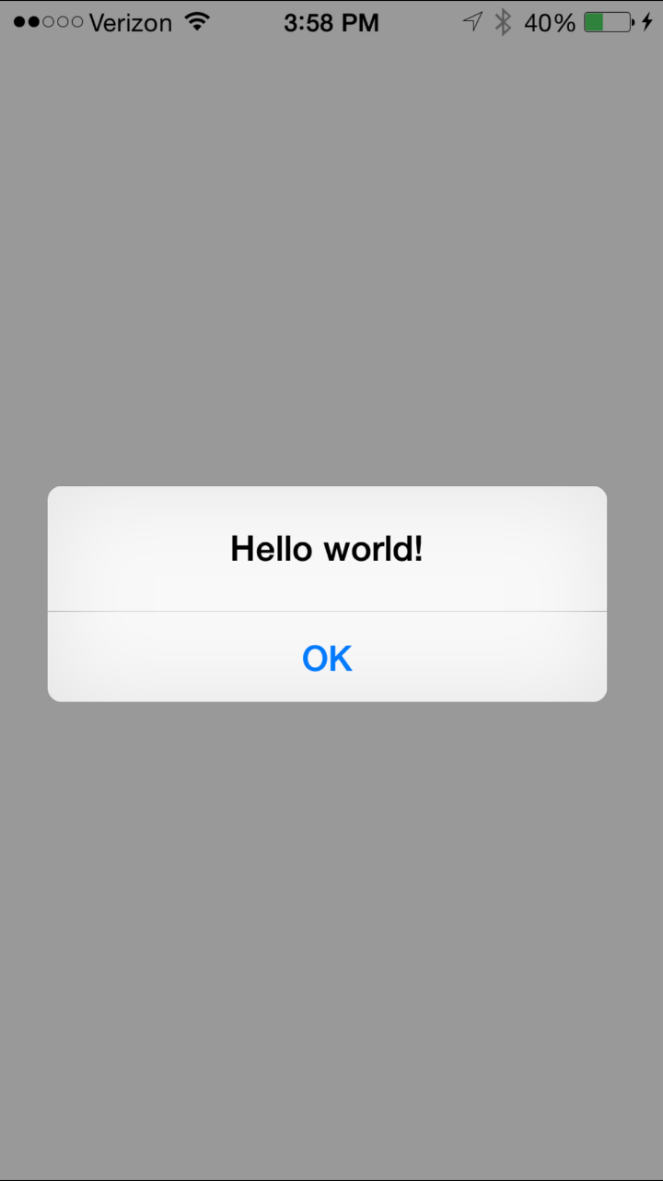
4
100% access to Android and iOS APIs
Notes:
Npm, CocoaPods, Android Arsenal

Slide 16
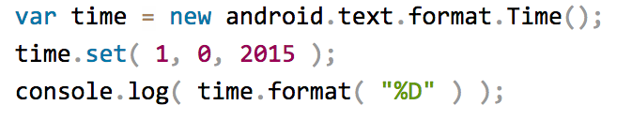


Runs on V8 JavaScript VM
Runs on JavaScriptCore VM
More details at http://bit.ly/how-nativescript-works

Slide 17
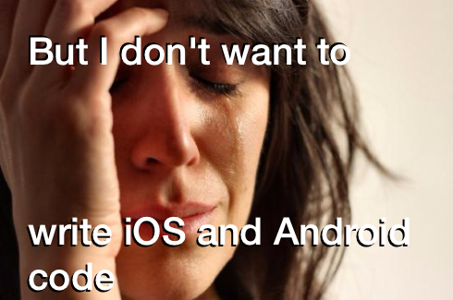

Slide 18
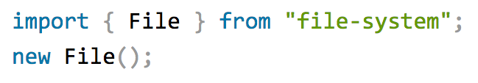

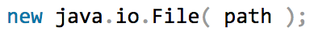

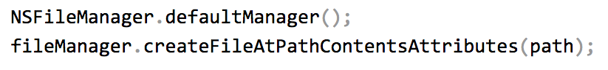
Example: NativeScript file module

Slide 19
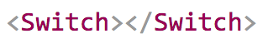
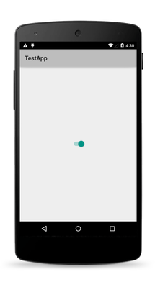
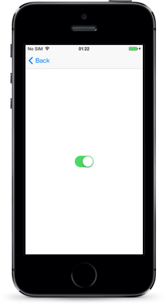
The same approach works for the UI

Slide 20
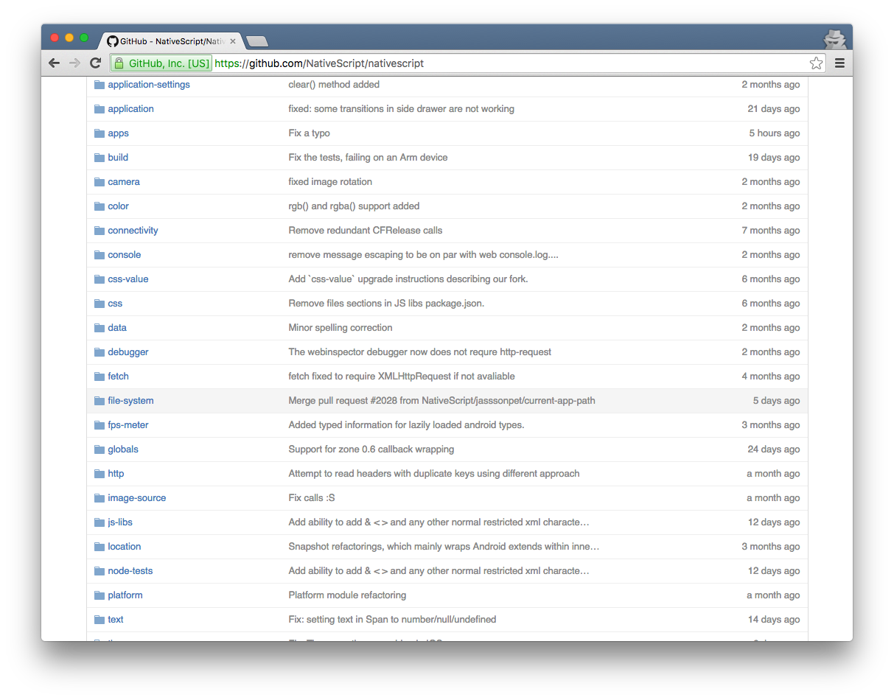
NativeScript Modules—There are a lot

Slide 21

Carlos Rubio
@crubio_zgz

Slide 22
Our vision
Benefits
Flexible Teams
Code Reuse
Reduce
development
cycles
Simplify
Maintenance
Easier to add
new channels
Unified User
Experience

Slide 23
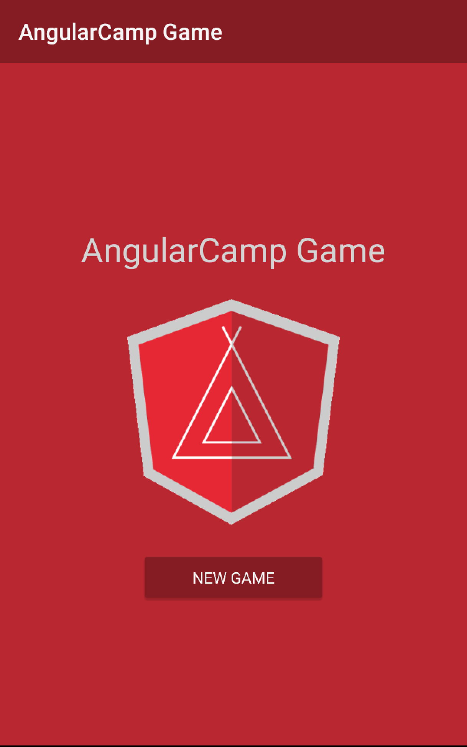
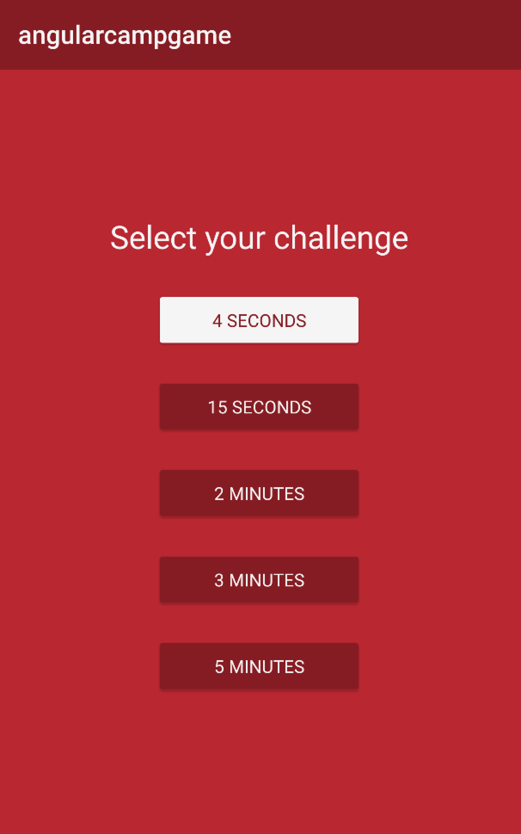
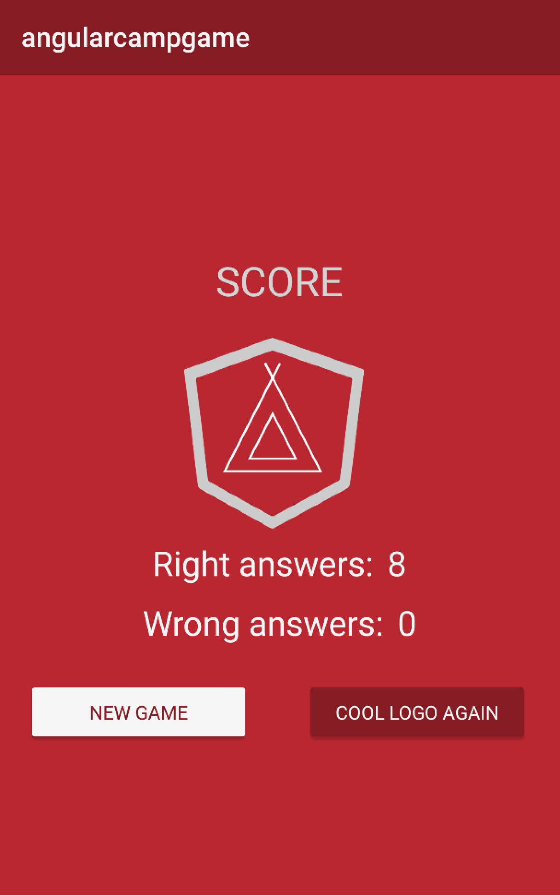

How we started?
Angular Camp
January 2016
NativeScript 1.5

Slide 24



Why to use NativeScript vs Webview?
We picked two main reasons
March 2016
NativeScript 1.7

Slide 25
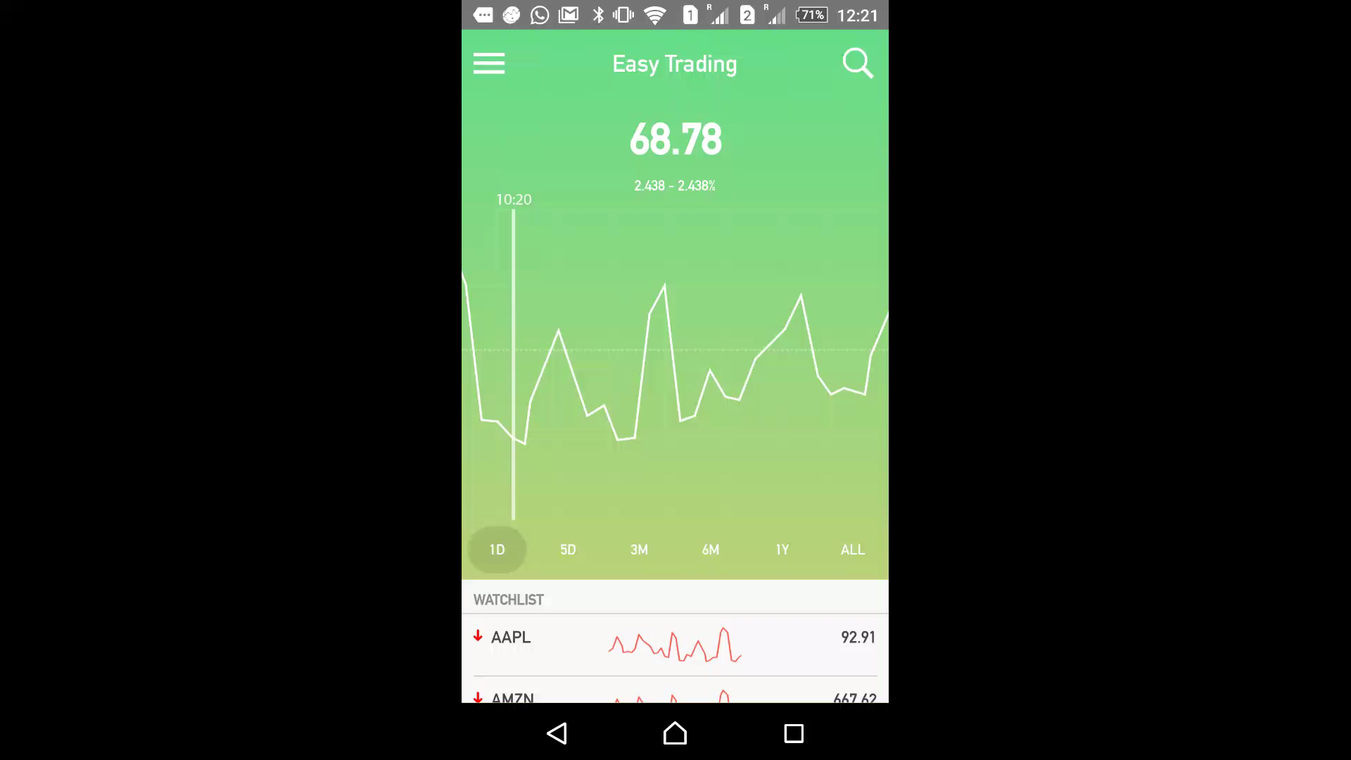
Our first business focused app
Easy Trading concept App for our Digital Banking Laboratory
May 2016
Nativescript 2.0

Slide 26
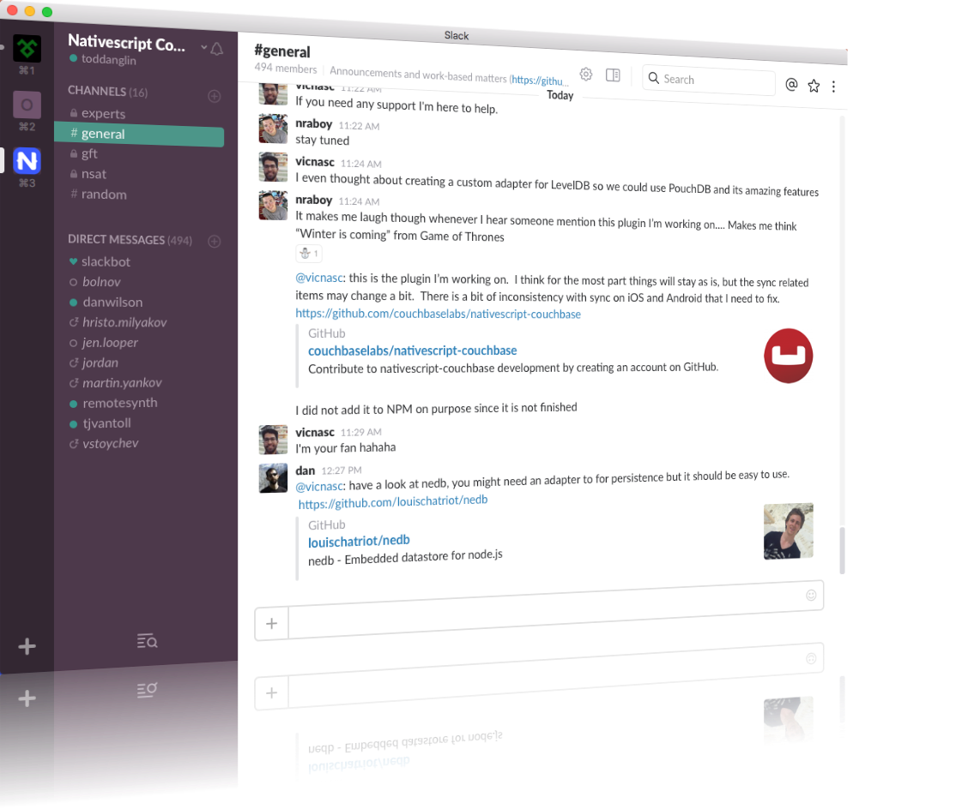
Join the growing NativeScript community on Slack
bit.ly/nativescript-slack

Slide 28
Hands-on workshop
Visit https://www.nativescript.org/ and click Get Started.

Slide 29
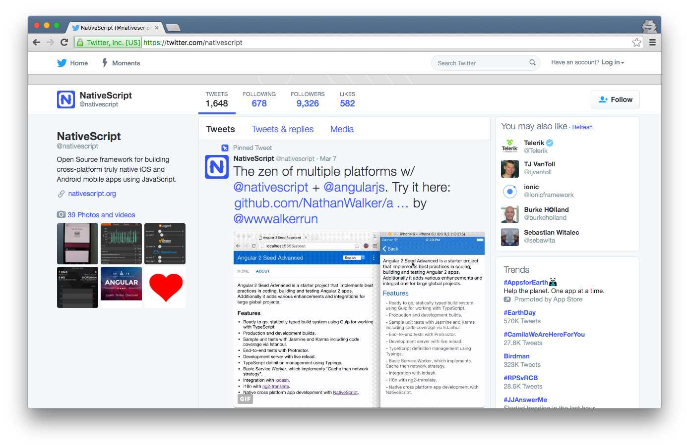
https://twitter.com/nativescript

